Slide 1
A comparison of Time Series Classification Algorithms based on their ability to learn in an Early Classification Context Ismail Wahba 10 June 2021

Slide 2
Agenda
Introduction
Motivation
Research Questions
Data Sets
Methodology
Conclusion
Future Work
Questions

Slide 3
Introduction
Time Series field has been thriving in the last decade
Personal Gadgets
Smart home sensors
Time Series Classification (TSC)
Accuracy
Space and Time Complexity
Full data is available
Early Time Series Classification (eTSC)
Accuracy and Earliness
Time is important, classify as early as possible

Slide 4
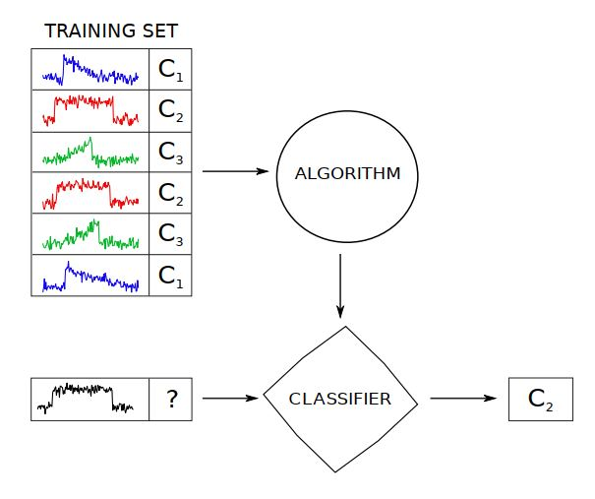
Introduction
Time Series field has been thriving in the last decade
Personal Gadgets
Smart home sensors
Time Series Classification (TSC)
Accuracy
Space and Time Complexity
Full data is available
Early Time Series Classification (eTSC)
Accuracy and Earliness
Time is important, classify as early as possible
Time Series Classification [12]

Slide 5
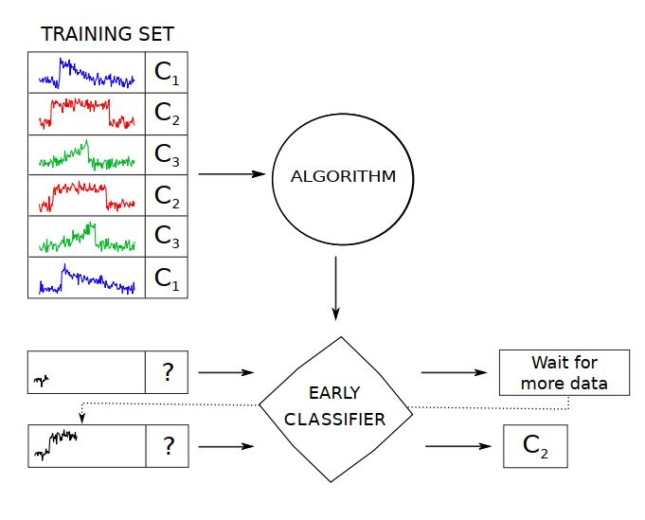
Introduction
Time Series field has been thriving in the last decade
Personal Gadgets
Smart home sensors
Time Series Classification (TSC)
Accuracy
Space and Time Complexity
Full data is available
Early Time Series Classification (eTSC)
Accuracy and Earliness
Time is important, classify as early as possible
Early Time Series Classification [12]

Slide 6
Motivation
Study of the relationship between TSC and eTSC, by examining the possibility of adjusting the former to deal with earliness.
What if we create an early context for TSCAs to operate in
Competent TSCAs that attain high accuracy and earliness can be used for early classification purposes
For example: audiological examinations are strenuous for patients and shortening them can help decrease discomfort

Slide 7
Research Questions
Research Question 1 (RQ1): How to adapt existing TS classification workflow for the early TS scenario ?
Research Question 2 (RQ2): How to evaluate the classifiers in the early TSC context, combining accuracy and earliness ?
Research Question 3 (RQ3): How to evaluate the proposed solution ?

Slide 8
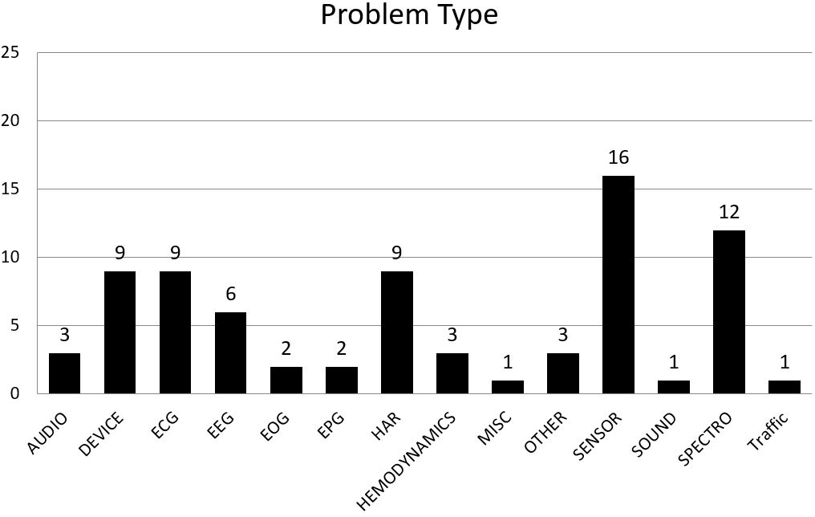
Data Sets
UCR univariate time series data archive [13]
UEA multivariate time series data archive [14]
Data Sets with real time series behind
Instances has same length
No missing values
Total of 77 data sets
55 univariate
22 multivariate

Slide 9
Related Work
Time Series Classification Algorithms Groups:
Distance-based (Whole) time series
Phase dependant (Interval-based)
Phase independant (Shapelets)
Dictionary based (BOP)
Ensembles
Deep Learning

Slide 10
Related Work
Other frameworks to compare TSCAs over many data sets
The great bake off [1]
18 algorithms
85 univariate data sets (UCR)
Deep Learning for time series classification [4]
9 DL algorithms
85 univariate data sets (UCR)
Multivariate bake off [5]
16 multivariate algorithms
30 multivariate data sets (UEA)

Slide 11
Methodology
Early Classification Context
Algorithms used
Proposed solution

Slide 12
Methodology - Context
What is Early Classification Context ?
Train algorithms on labeled but incomplete time series instances
Classify full length instances
Investigate if algorithm can learn about the problem without waiting for full data
Compare to performance if full data was available

Slide 13
Methodology - Algorithms
Classical baselines: 1-NN ED & 1-NN DTW
Distance based: Proximity Forest [7], Move-Split-Merge (MSM) [6]
Interval based: Time Series Forest (TSF) [8]
Shapelets: Learned Shapelet (LS) [10], Shapelet Transform (ST) [9]
Dictionary based: WEASEL [3], Bag of SFA Symbols (BOSS) [11]
Deep learning: Inception-Time [2]
Baseline Classifier (majority class)
Column Ensembling for multivariate data sets

Slide 14
Methodology – Framework
Research Question 1 (RQ1): How to adapt existing TS classification workflow for the early TS context?
Instead of learning on full length data
Simulate an incremental learning process
Chop the data and learn on only chunks of the training instances
Evaluate performance in comparison to performance on full length

Slide 15
Methodology – Framework
Research Question 1 (RQ1): How to adapt existing TS classification workflow for the early TS context?
Instead of learning on full length data
Simulate an incremental learning process
Chop the data and learn on only chunks of the training instances
Evaluate performance in comparison to performance on full length

Slide 16
Methodology – Framework
A framework that implements the early classification context
Chop the training data into smaller chunks
Learn classifiers on chunks of the training instances
Evaluate performance in comparison to performance on full length

Slide 17
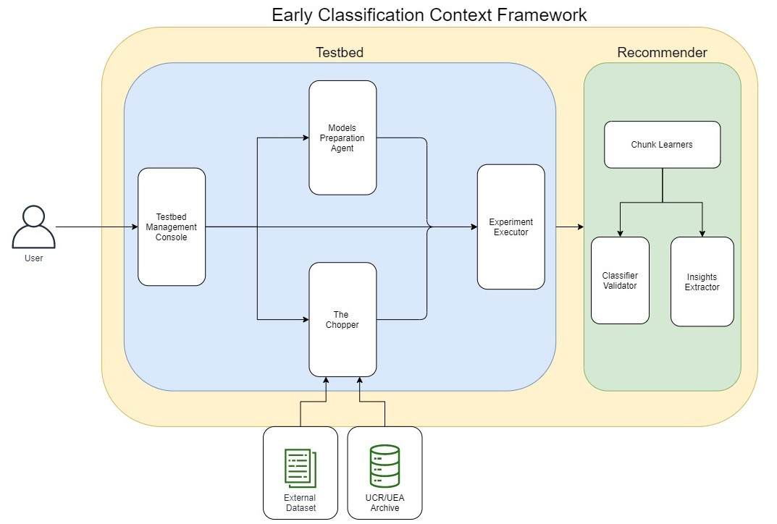
Methodology – Framework

Slide 18
Methodology – Framework
Framework implementing the early classification context
Testbed for comparing TSCAs in an early classification context
Recommender to suggest models for unseen data sets
Testbed
Cutting time series into 10 chunks (increments of 10%)
Use evaluation metric combining accuray and earliness as performance measure
Use performance of whole time series as baseline
Recommender:
Learn on performance results from testbed
Assess classifiers as good and bad for each data set

Slide 19
Methodology – Framework
Framework for simulating the early classification context
Testbed for comparing TSCAs in an early classification context
Recommender to suggest models for unseen data sets
Studying TSC in eTSC context
Use performance on whole time series as baseline
Cutting time series in increments of 10%
Use evaluation metric combining accuray and earliness as performance measure
Recommendations:
Learn on performance results in the early context
Assess classifiers as good and bad for each data set

Slide 20
Methodology – Framework

Slide 21
Methodology – Framework

Slide 22
Methodology – Framework

Slide 23
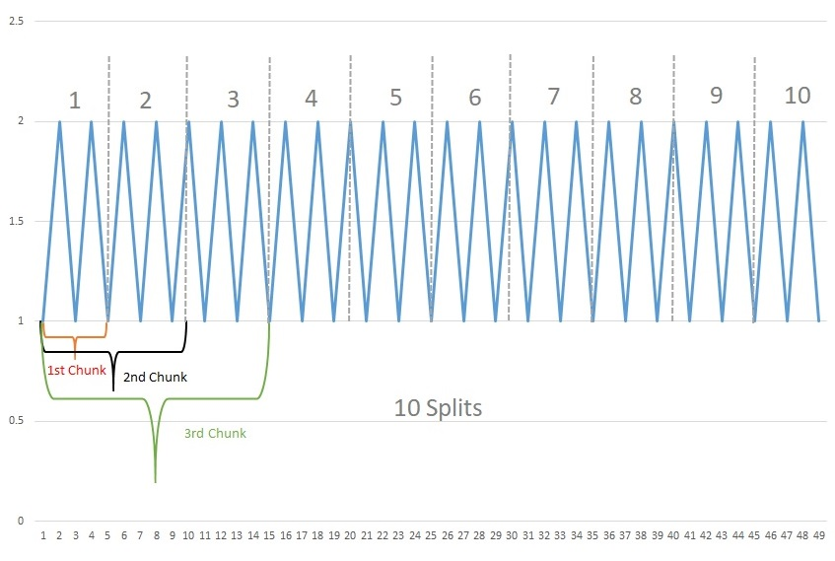
Methodology - The Chopper

Slide 24

Methodology – Framework
Research Question 2 (RQ2): How to evaluate the classifiers in the early TSC context, combining performance and earliness ?
eTSC solution:
Harmonic mean of Accuracy and Earliness
Beta = 1, accuracy and earliness are equally important

Slide 25
Methodology – Framework
Research Question 2 (RQ2): How to evaluate the classifiers in the early TSC context, combining performance and earliness ?
Our Solution:
Performance measure: Balanced Accuracy
Earliness: Revealed% of data (depends on chunk)
Beta = 0.5, accuracy is twice as important as earliness

Slide 26
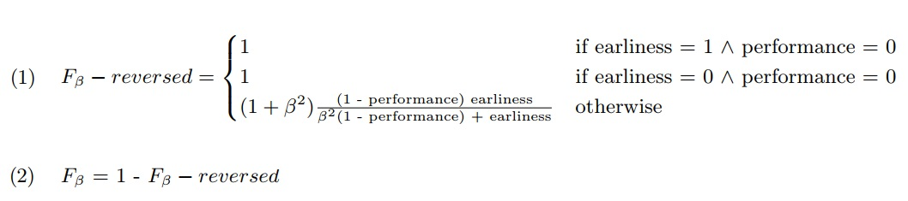
Methodology – Framework
Research Question 2 (RQ2): How to evaluate the classifiers in the early TSC context, combining performance and earliness ?

Slide 27
Methodology – Framework

Slide 28
Methodology – Framework
Research Question 3 (RQ3): How to evaluate the proposed solution ?
Learn a Recommender
Learns the performance of classifiers per chunk
Provide insights about the important features
Suggests good performing classifiers for unseen data sets

Slide 29
Methodology – Framework

Slide 30
Methodology – Framework
Random Forest Regressor per chunk
Predict F-scores for all classifiers and majority class baseline
Good Classifiers better than baseline

Slide 31
Results
TSF (76 data sets)
WEASEL & CBOSS (72 data sets)
ST (61 data sets)
PForest (42 data sets)
KNN-ED and Inception Time failed to handle the early classification context
LS & MSM results lower than the published results
KNN-DTW failed due to code failure

Slide 32
Results
Results for Testbed
Within same classifier (across chunks)
Across different classifiers (on same chunk)
Data characteristics in relation to performance
Duration
Results for Recommender
Preditcting F-scores
Features contribute to final prediction
Final Recommendation

Slide 33
Results
TSF, WEASEL, CBOSS, ST and Pforest worked in the early context
KNN-ED and Inception Time failed to handle the early classification context
LS & MSM results lower than the published results
KNN-DTW failed due to code failure

Slide 34
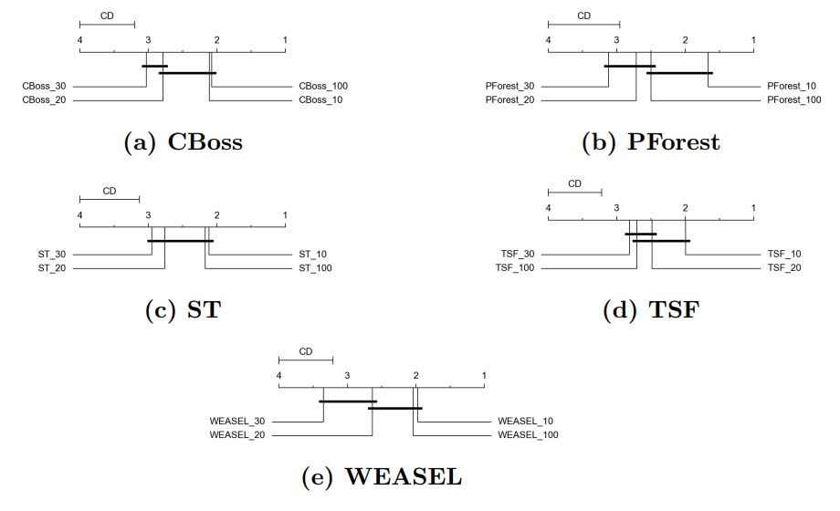
Testbed Results – Within Classifier

Slide 35
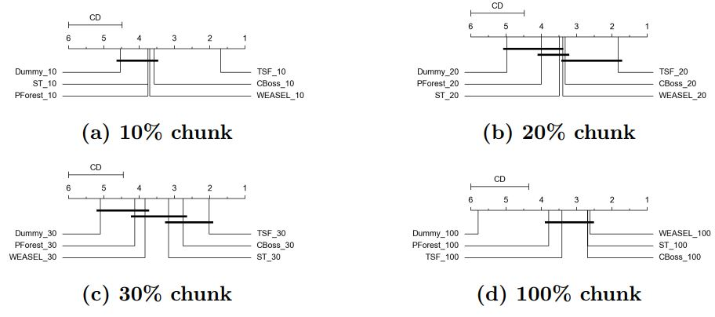
Testbed Results – Across Classifiers

Slide 36
Recommender Results – Predicting F-Scores
Revealed% | Avg MAE | Avg RMSE
10 | 4.82 | 6.71
20 | 9.57 | 12.42
30 | 12.03 | 15.46
100 | 15.58 | 19.52
Overall performance of chunk learners in predicting actual F-scores over 50 runs

Slide 37
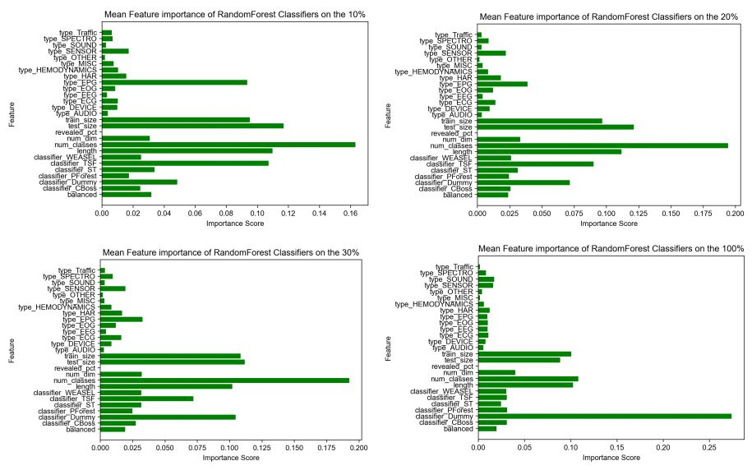
Recommender Results – Feature Importance

Slide 38
Recommender Results – Final Recommendation
High Accuracy and Recall
Relatively lower precision on lower chunks
Baseline classifier plays important role
Revealed% | Avg Accuracy | Avg Recall | Avg Precision
10 | 73.62 | 0.9520 | 0.6920
20 | 80.19 | 0.9597 | 0.7769
30 | 86.15 | 0.9925 | 0.8346
100 | 95.80 | 1.0000 | 0.9481
Overall Performance of chunk learners in predicting good and bad performers over 50 runs

Slide 39
Conclusion - Testbed
In general, TSF is better than all other classifiers on early chunks
All classifiers are not significantly different from each other on full length
10% classifiers are not statistically different from the 100% classifiers based on F-score due to role of earliness
Beta value has great effect on results of testbed
No clear relation between data characteristics and performance of classifiers in early classification context

Slide 40
Conclusion - Recommender
Recommender tends to over estimate performance of classifiers
RMSE = 6.71% on 10% chunk but increases to 19.52% on full length
Regardless of the error, still recommends good classifiers
Baseline classifier has great effect on results of recommender
Recommender depends mainly on data set features for recomemdations

Slide 41
Future Work
Cover a broader spectrum of time series problem types
Use bespoke multivariate classifiers to learn relations between dimensions
Investigate understandability under the early classification context for classifiers like TSF and ST
More granular chunks and comparison across more chunks
Using a time series classifier as baseline in recommender

Slide 42
Thank you for your attention!
www.ovgu.de

Slide 43
Appendix
www.ovgu.de

Slide 44
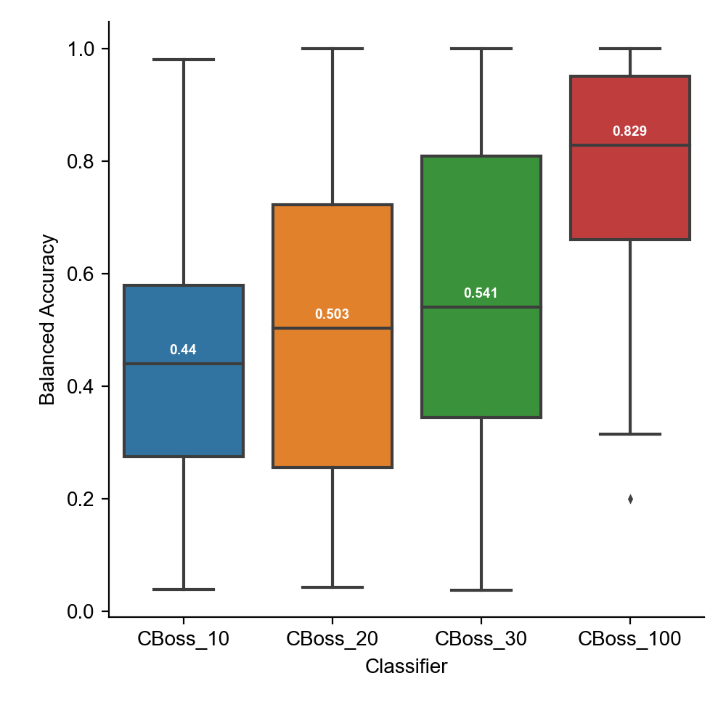
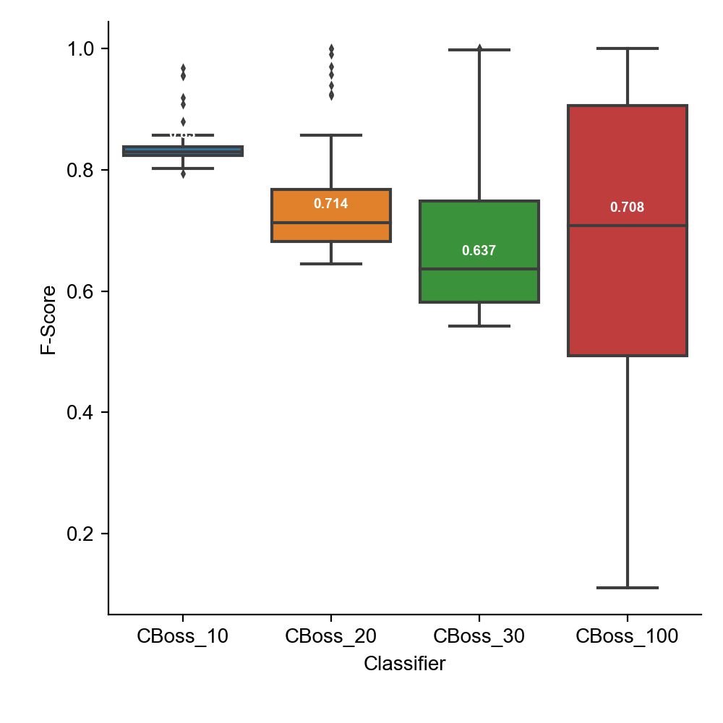
Harmonic Mean: Equal importance of accuracy and earliness
www.ovgu.de

Slide 45
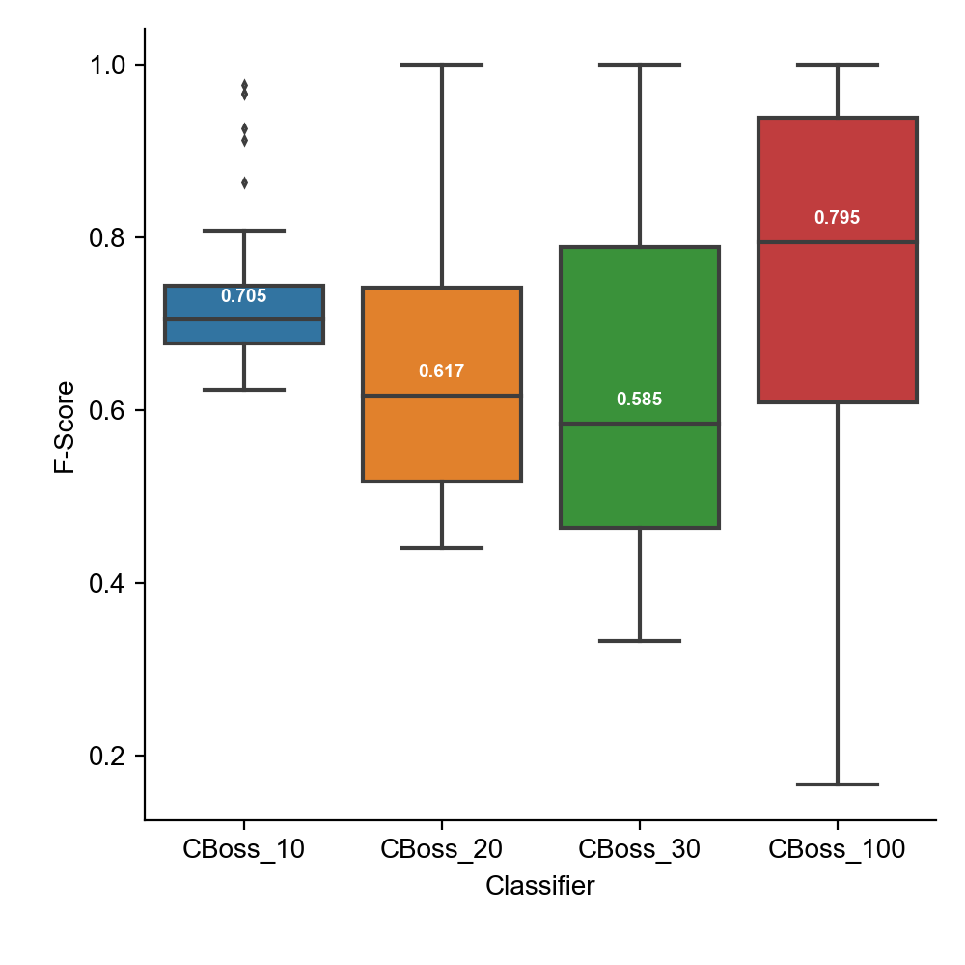
Accuracy twice important as earliness
www.ovgu.de

Slide 46
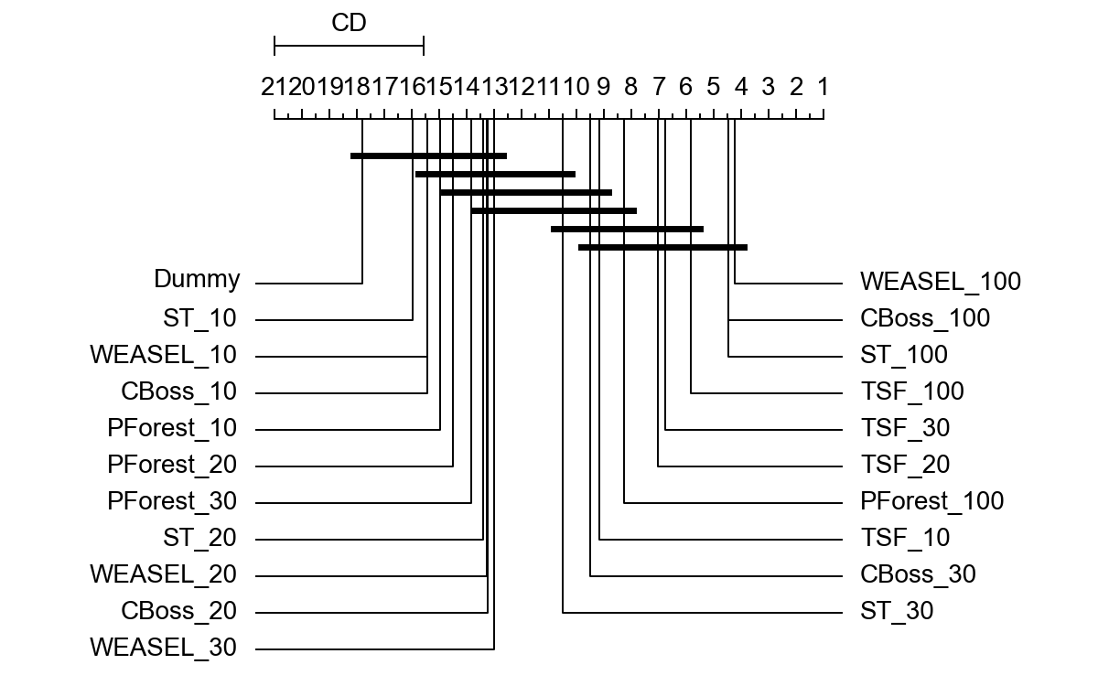
CD diagram All classifiers
(Balanced Accuracy)
www.ovgu.de

Slide 47
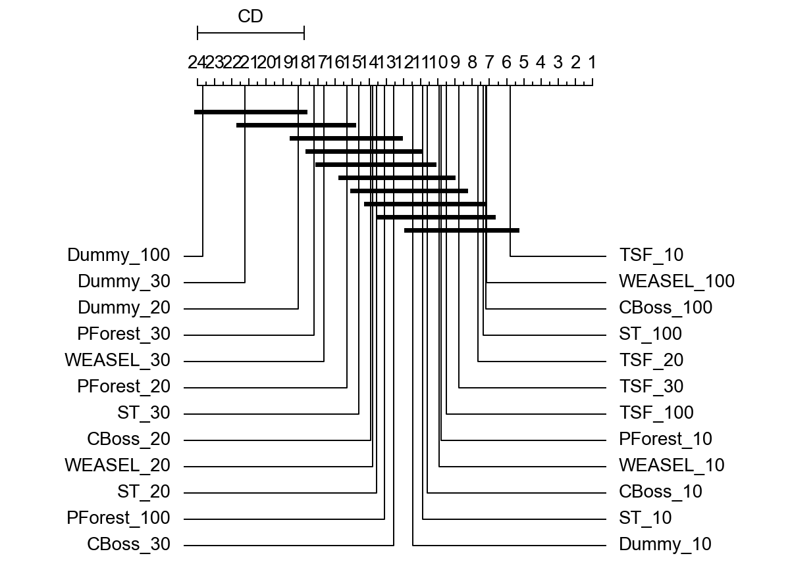
CD diagram All classifiers
(F-score)
www.ovgu.de

Slide 48
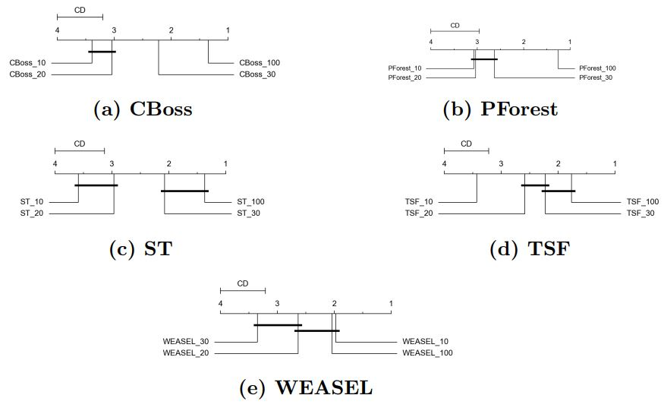
CD diagram within
(Balanced Accuracy)
www.ovgu.de

Slide 49
CD diagram within
(F-score)
www.ovgu.de

Slide 50
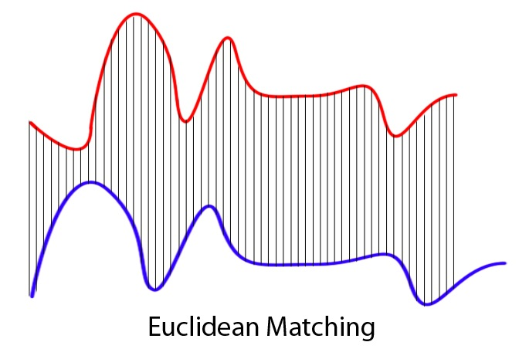
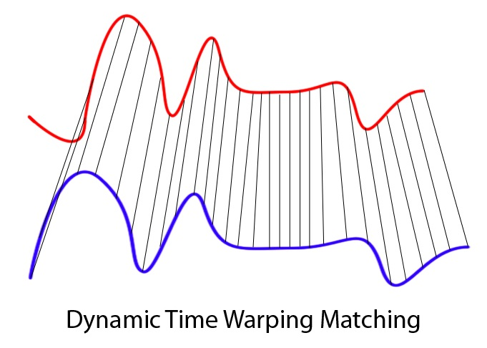
Background and Context
Conventional Time Series Classification Algorithms Groups [1]:
Whole time series
Phase dependant
Phase independant
Dictinoary based
Ensembles
Model based
Figure: 1NN using ED vs DTW [10]

Slide 51
References
[1] Bagnall, Anthony, et al. "The great time series classification bake off: a review and experimental evaluation of recent algorithmic advances." Data Mining and Knowledge Discovery 31.3 (2017): 606-660.Goals, Theses and Questions
[2] Fawaz, Hassan Ismail, et al. "Inceptiontime: Finding alexnet for time series classification." Data Mining and Knowledge Discovery 34.6 (2020): 1936-1962.Methodology
[3] Schäfer, Patrick, and Ulf Leser. "Fast and accurate time series classification with weasel." Proceedings of the 2017 ACM on Conference on Information and Knowledge Management. 2017.
[4] Fawaz, Hassan Ismail, et al. "Deep learning for time series classification: a review." Data Mining and Knowledge Discovery 33.4 (2019): 917-963.
[5] Ruiz, Alejandro Pasos, et al. "The great multivariate time series classification bake off: a review and experimental evaluation of recent algorithmic advances." Data Mining and Knowledge Discovery (2020): 1-49.
[6] Stefan, Alexandra, Vassilis Athitsos, and Gautam Das. "The move-split-merge metric for time series." IEEE transactions on Knowledge and Data Engineering 25.6 (2012): 1425-1438.
[7] Lucas, Benjamin, et al. "Proximity forest: an effective and scalable distance-based classifier for time series." Data Mining and Knowledge Discovery 33.3 (2019): 607-635.

Slide 52
References
[8] Deng, Houtao, et al. "A time series forest for classification and feature extraction." Information Sciences 239 (2013): 142-153.
[9] Lines, Jason, et al. "A shapelet transform for time series classification." Proceedings of the 18th ACM SIGKDD international conference on Knowledge discovery and data mining. 2012.
[10] Grabocka, Josif, et al. "Learning time-series shapelets." Proceedings of the 20th ACM SIGKDD international conference on Knowledge discovery and data mining. 2014.
[11] Schäfer, Patrick. "The BOSS is concerned with time series classification in the presence of noise." Data Mining and Knowledge Discovery 29.6 (2015): 1505-1530.
[12] Mori, Usue, et al. "Early classification of time series using multi-objective optimization techniques." Information Sciences 492 (2019): 204-218.
[13] Dau, Hoang Anh, et al. "The UCR time series archive." IEEE/CAA Journal of Automatica Sinica 6.6 (2019): 1293-1305.
[14] Bagnall, Anthony, et al. "The UEA multivariate time series classification archive, 2018." arXiv preprint arXiv:1811.00075 (2018).

